Slide 1

Subject: Supervised Learning — Non Linear Regression Analysis Module Number: 5
Module Name: Number Systems, Logic Gates and Combining Logic Gates

Slide 2
Non-linear regression model
Syllabus
Introduction to non-linear regression models.
non-linear least square method to estimating the regression parameters.
transformation of non-linear model to linear model.
linearization, other parameter estimation methods.
starting values, statistical inference in non-linear regression models.

Slide 3
Non-linear regression model
Syllabus
Introduction to non-linear regression models.
non-linear least square method to estimating the regression parameters.
transformation of non-linear model to linear model.
linearization, other parameter estimation methods.
starting values, statistical inference in non-linear regression models.

Slide 4
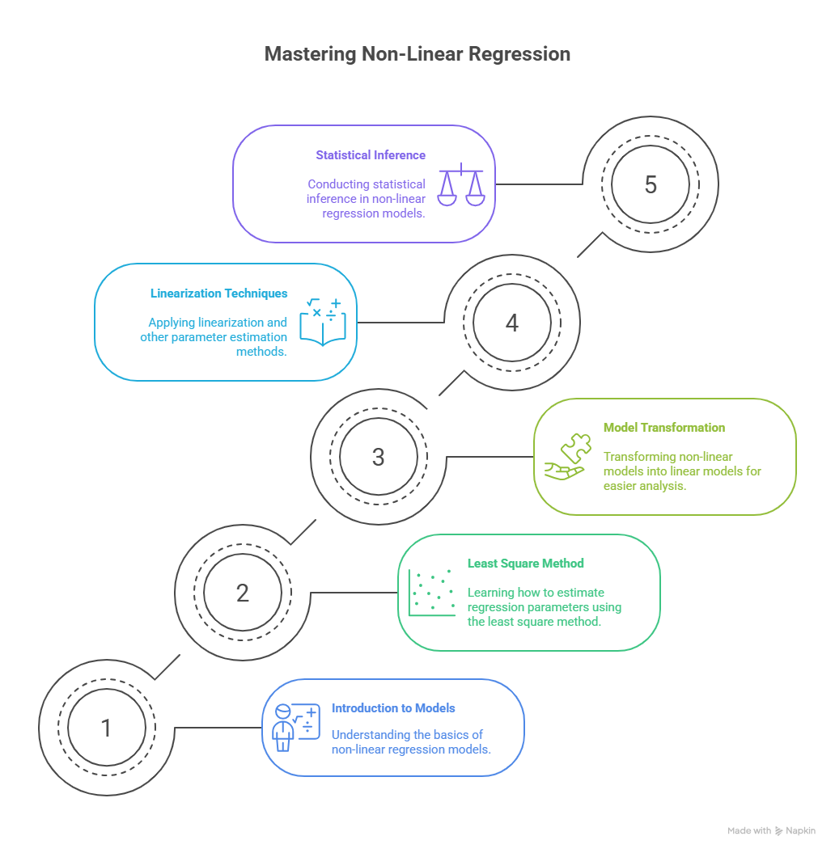
Introduction to non-linear regression models

Slide 5
What is Non-Linear Regression
Non-linear regression models the relationship between independent and dependent variables using non-linear functions.
Cannot be expressed as a linear combination of parameters: y=β0+β1x+ε(linear)y = \beta_0 + \beta_1 x + \varepsilon \quad \text{(linear)}y=β0​+β1​x+ε(linear) y=β0eβ1x+ε(non-linear)y = \beta_0 e^{\beta_1 x} + \varepsilon \quad \text{(non-linear)}y=β0​eβ1​x+ε(non-linear)

Slide 6
Linear vs Non-Linear Models
Feature | Linear Model | Non-Linear Model
Parameter relationship | Linear | Non-linear
Estimation | Closed-form (OLS) | Iterative
Examples | $y = \beta_0 + \beta_1x$ | $y = \beta_0 e^{\beta_1 x}$

Slide 7
Limitation of Linear Model
Graph: Line fit to exponential data (poor fit)
Visual: Residuals pattern showing systematic error
Interpretation: Linear model can't capture curvature

Slide 8
Examples of Non-Linear Models
Exponential: $y = a e^{bx}$
Logistic: $y = \frac{L}{1 + e^{-k(x - x_0)}}$
Power-law: $y = ax^b$
Saturation kinetics: $y = \frac{V_{\max} x}{K_m + x}$
[Insert plot placeholders]

Slide 9
Types of Non-Linearity
Intrinsic non-linearity: Model itself is non-linear
Extrinsic non-linearity: Can be transformed into linear
Emphasize difference using example: y=β0xβ1y = \beta_0 x^{\beta_1}y=β0​xβ1​ → Intrinsic

Slide 10
Model Specification
Structure of a non-linear regression model: yi=f(xi,θ)+εiy_i = f(x_i, \boldsymbol{\theta}) + \varepsilon_iyi​=f(xi​,θ)+εi​
$f$ is a known non-linear function
$\boldsymbol{\theta}$ are parameters to estimate
$\varepsilon_i$ ~ i.i.d. Normal(0, $\sigma^2$)

Slide 11
Real-World Use Cases
Biology: Dose-response modeling
Economics: Growth curves
Engineering: Saturation models
Marketing: Diminishing returns models

Slide 12
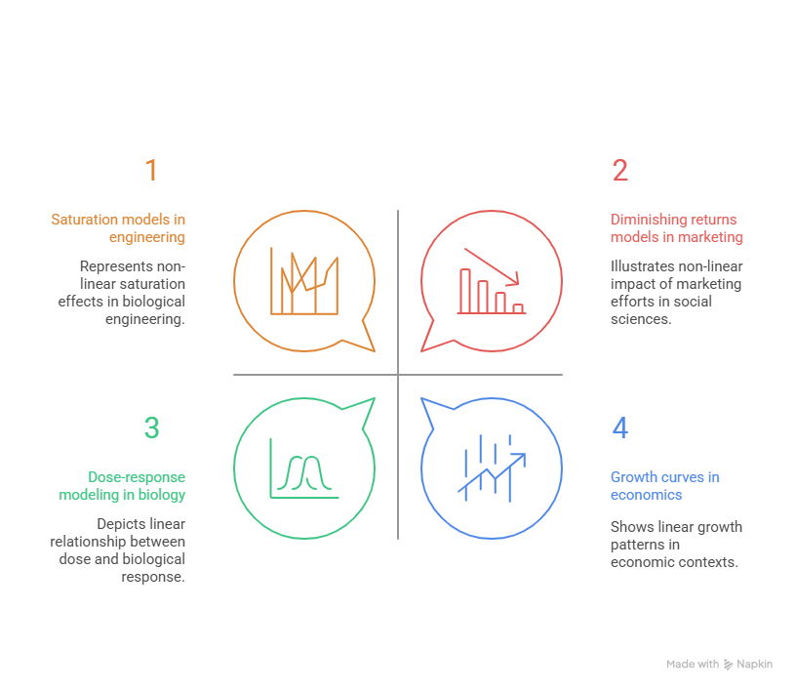
Real-World Use Cases

Slide 13
Key Challenges
Choosing the correct model form
Estimating parameters without closed-form solution
Risk of overfitting or poor convergence

Slide 14
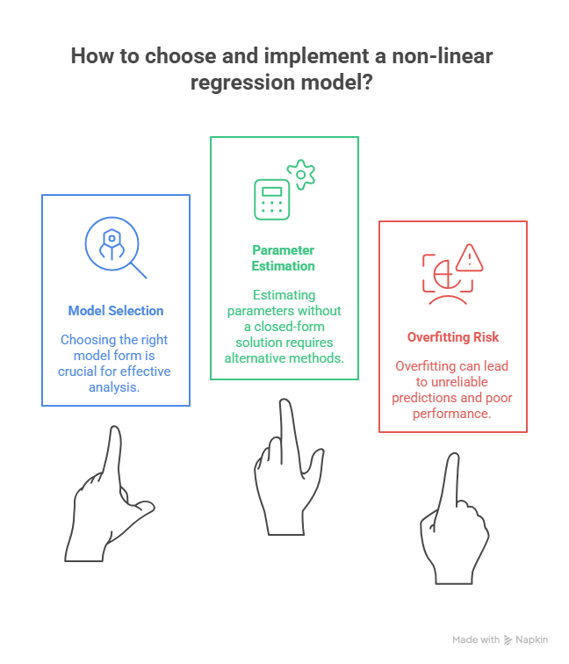
Key Challenges

Slide 15
Key Takeaways
Non-linear regression is needed when data follows curved relationships.
Cannot rely on OLS; need iterative estimation.
Model selection and validation are critical.

Slide 16
NLLS
Definition of NLLS: It estimates parameters by minimizing the sum of squared errors for a non-linear model.
Objective function: S(θ)=∑i=1n​[yi​−f(xi​,θ)]2 This measures how far predictions are from actual values.
Used when OLS fails: NLLS is necessary when the relationship between parameters and predictors is non-linear.

Slide 17
Revisiting the Linear Case
Linear models are additive in parameters: Linearity means parameters enter the model as a linear combination.
NLLS needs iteration: For non-linear models, analytical solutions are not available.
OLS solution: β^​=(XTX)−1XTy This gives a direct solution for linear models.

Slide 18
Geometry of NLLS
Residual as vector distance:
The difference between observed and predicted values forms a residual vector.
Goal: minimize residual norm:
We minimize the squared length of this vector to fit the model.
Optimization landscape is curved:
Unlike OLS, the error surface in NLLS can be rugged and complex

Slide 19
Objective Function
Expressed as a norm:
S(θ)=∥y−f(θ)∥2
This is a compact vector form of SSE.
Function of parameters only:
The goal is to find the best $\theta$ to minimize this norm.
Highly sensitive to model form:
Slight changes in $f$ can affect convergence

Slide 20
Properties of the SSE Surface
Multiple local minima:
The function may have many dips, not just one best solution.
Non-convex surface:
The surface can have irregular curves, making optimization hard.
Sensitive to parameter scaling:
Poorly scaled parameters distort the error surface.

Slide 21
Non-linear regression model

Slide 22
Non-linear regression model

Slide 23
Non-linear regression model

Slide 24
Non-linear regression model

Slide 25
Non-linear regression model

Slide 26
Non-linear regression model

Slide 27
Non-linear regression model

Slide 28
Non-linear regression model

Slide 29
Non-linear regression model

Slide 30
Non-linear regression model

Slide 31
Non-linear regression model

Slide 32
Non-linear regression model

Slide 33
Non-linear regression model

Slide 34
Non-linear regression model

Slide 35
Non-linear regression model

Slide 36
Non-linear regression model

Slide 37
Non-linear regression model

Slide 38
Non-linear regression model

Slide 39
Non-linear regression model

Slide 40
Non-linear regression model

Slide 41
Non-linear regression model

Slide 42
Non-linear regression model

Slide 43
Non-linear regression model

Slide 44
Non-linear regression model

Slide 45
Non-linear regression model

Slide 46
Non-linear regression model

Slide 47
Non-linear regression model

Slide 48
Non-linear regression model

Slide 49
Non-linear regression model

Slide 50
Non-linear regression model

Slide 51
Non-linear regression model

Slide 52
Non-linear regression model

Slide 53
Non-linear regression model

Slide 54
Non-linear regression model

Slide 55
Non-linear regression model

Slide 56
Non-linear regression model

Slide 57
Non-linear regression model

Slide 58
Non-linear regression model

Slide 59
Non-linear regression model

Slide 60
Non-linear regression model

Slide 61
Non-linear regression model

